Slide 1



Medlivery
Medicine & Wellness Products Delivery App
Github - https://github.com/skhetanNEU/Medlivery
Medlivery
Aadesh Mallya
Satvik Khetan
Rishi Goswamy
Abhishek Kumar

Slide 2
What is our app?
An application to make the process of purchasing health and wellness products, obtaining prescription medications, and managing your healthcare needs more convenient and efficient.
Basically, Uber Eats / DoorDash but for health & wellness products instead of artery-clogging food.
Notes:
<a href="https://www.freepik.com/free-photos-vectors/people">People vector created by pch.vector - www.freepik.com</a>

Slide 3
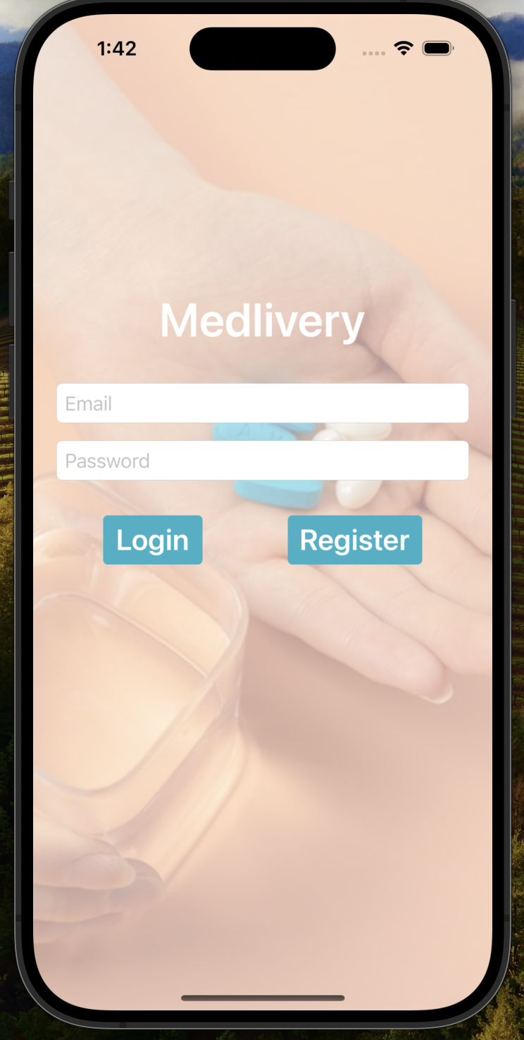
Login
When the user opens the app for the first time, they will see this Login screen.
The user can either log in with existing email and password or click on Register to register as a new user.

Slide 4
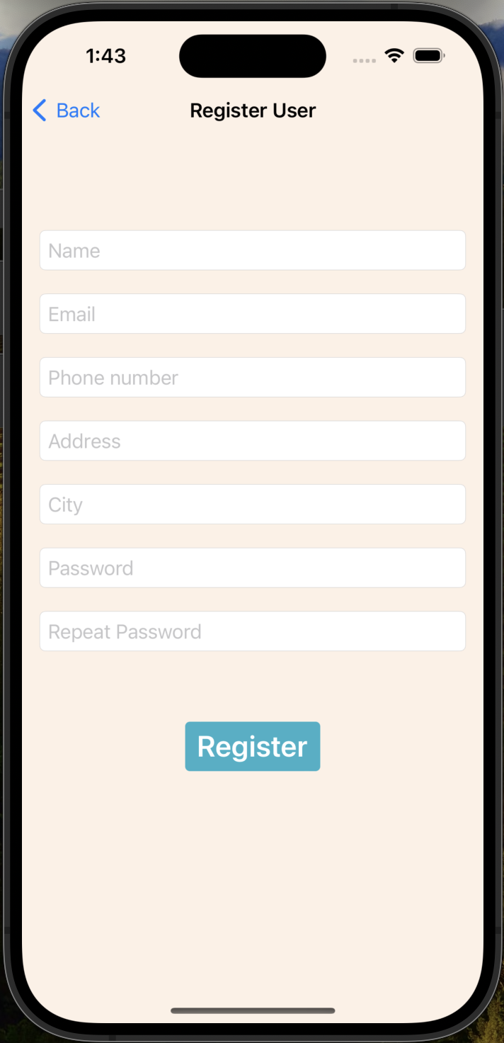
Register
We can register as a new user by providing the details such as name, address, phone number and a password.
Since we have a customer support user with the email support@medlivery.com, we are restricting users to register with this email.
Checks for invalid email, invalid phone, empty addresses, etc. are in place to avoid any invalid registration.
If a user with the email already exists, then it will error out stating user already exists.

Slide 5
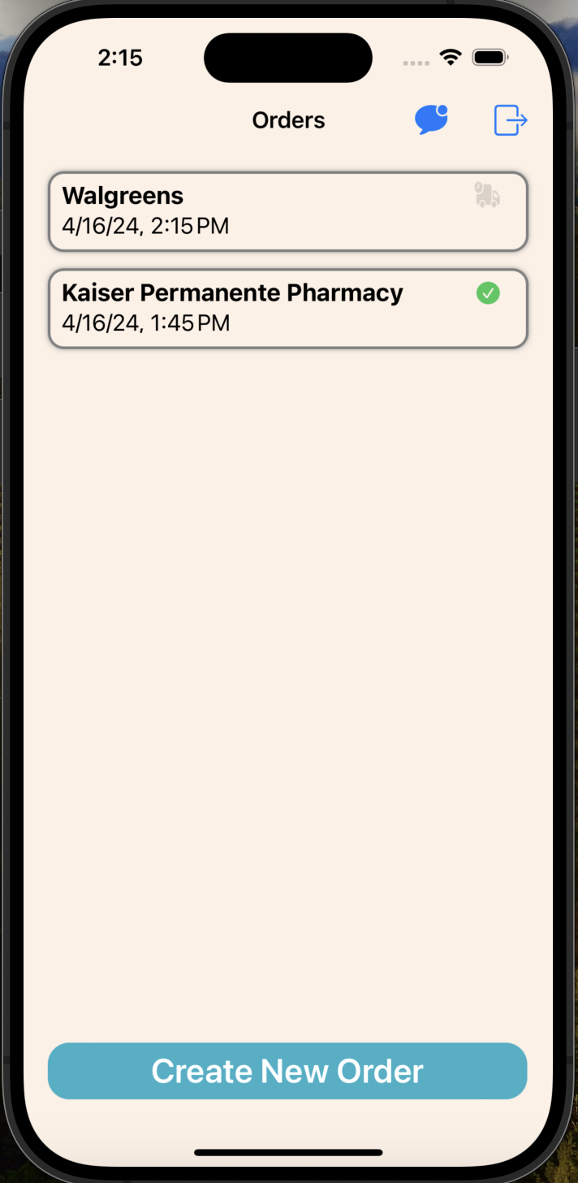
Orders
When the user logs in or registers, they can see the orders for the user. If they are already logged in and they open the app, they directly see this screen
User can logout from the main screen using the door icon on the top right of the screen.
It shows all the current and past orders with details such as the store name, time and date.
It also shows an animation for the orders which are yet to be completed and shows a green checkmark for the orders which are completed.
User can click on “Create Order” to create a new order.

Slide 6
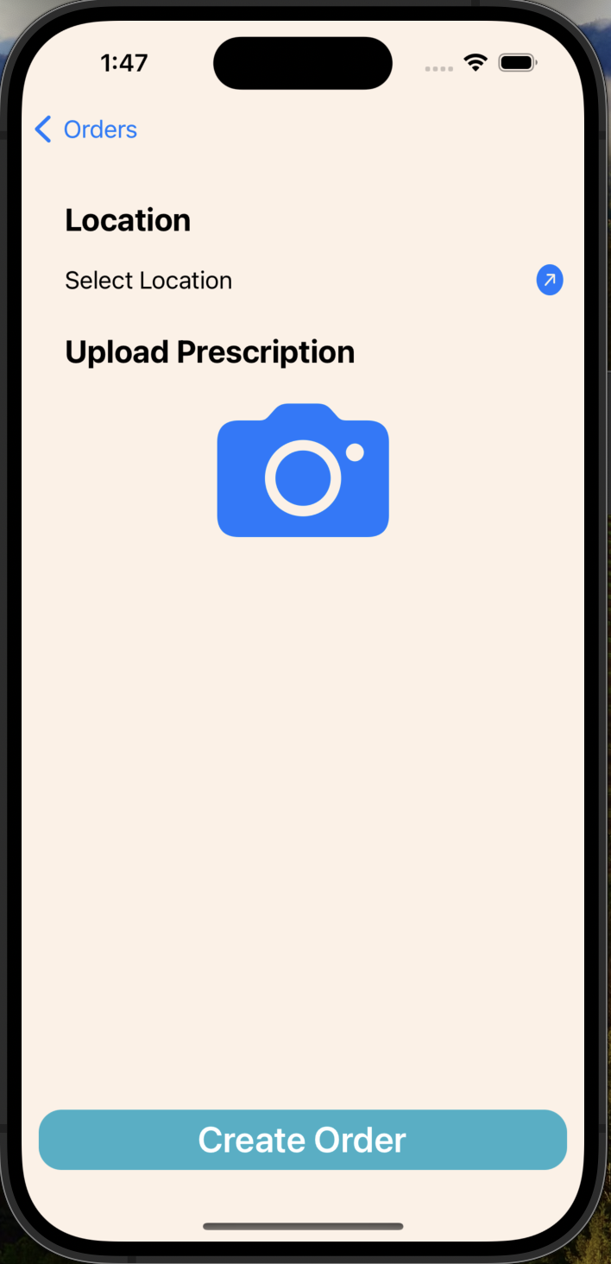
Create Order
When the user clicks on Create Order, it will open this screen where the user selects a store and upload an image of the prescription to place an order.
Both the location and the prescription are required and user won’t be able to create a new order without any of them.
When user finally clicks on “Create Order”, they are redirected to the home screen where they would see this order on the top of the list with the status representing its not yet completed.

Slide 7
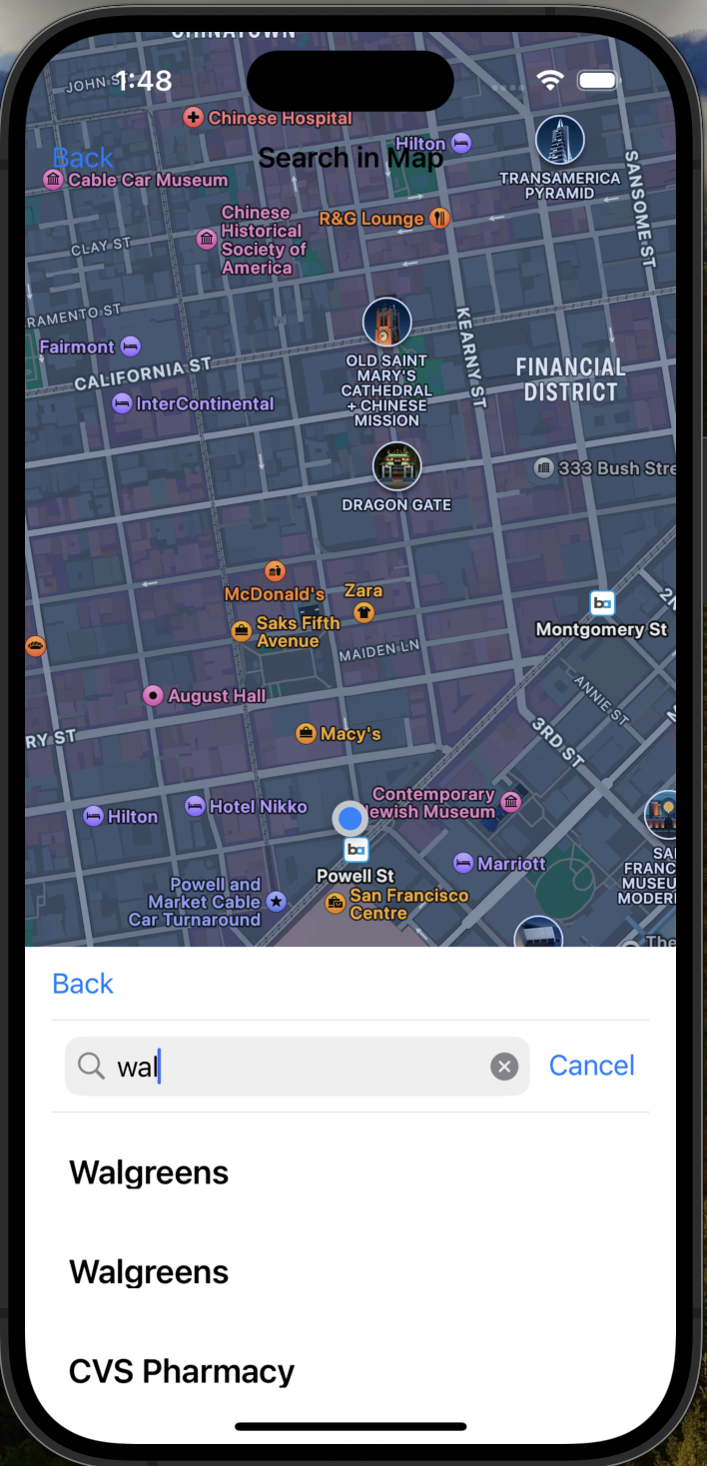
Selecting Store Location
When creating an order, the user has to select a location for the store.
When they click the arrow next to the select location, they will be redirected to map where they can search for pharmacies near by and select any one of them.
Once they select the store, they will be redirected to the Create Order screen with their selected store showing up under the “Location” label.

Slide 8
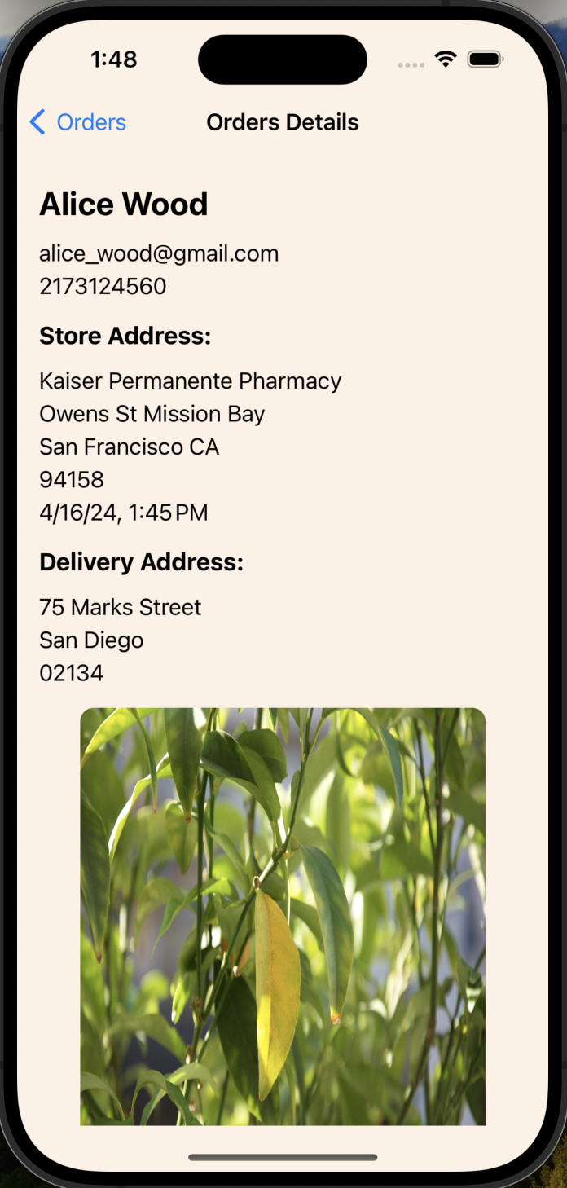
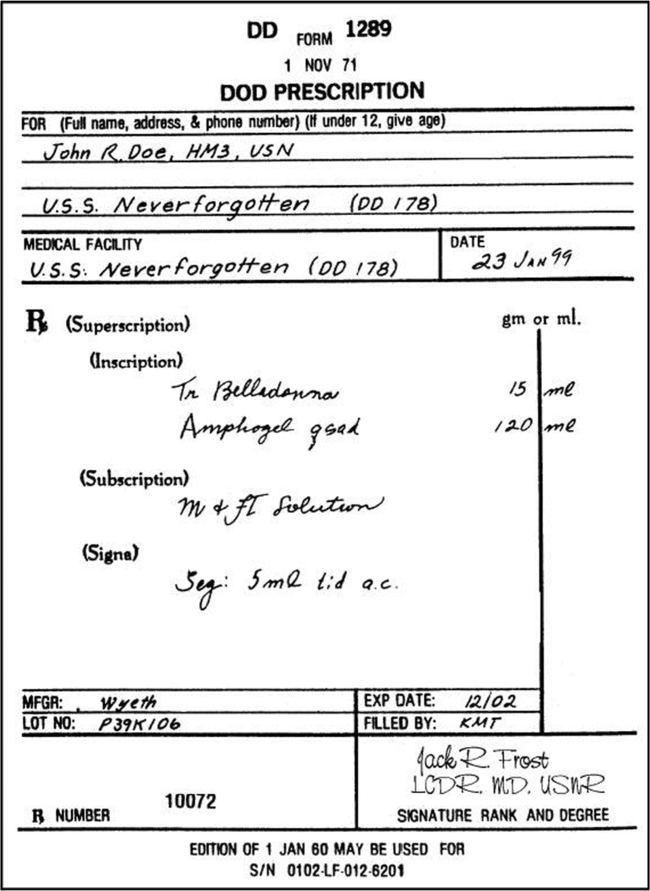
Order Details
When user clicks on any of the orders, it will open another screen where user can see the details of the order.
Details include the user’s details, store and delivery address along with the prescription image that was uploaded.

Slide 9
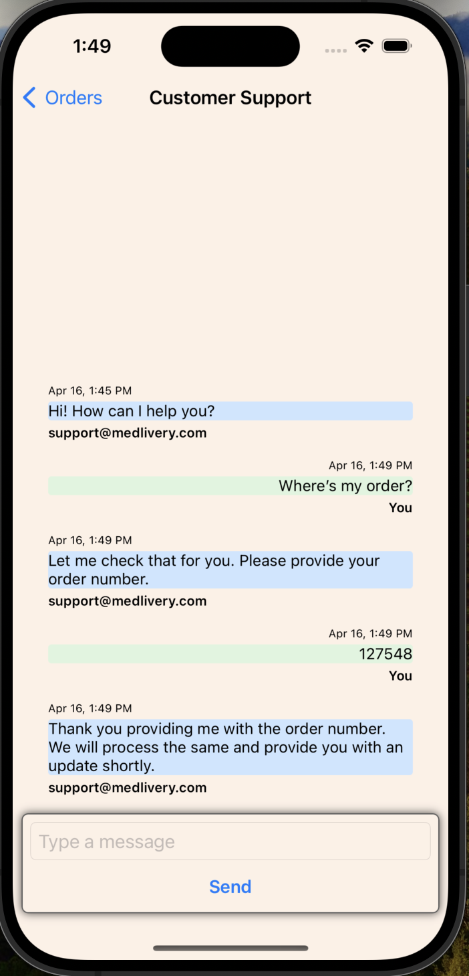

Customer Support
When user is on home screen, they have the option to chat with the customer support regarding any of the orders.
They can click on icon on the home screen and it will open the user’s chat with customer support.
User can chat regarding any queries they might have regarding the order, delivery issues, etc.
Currently, we have a bot responding to the questions but in future we would be adding Machine Learning and actual human capabilities to the chat.

Slide 10
Thank you

